Slide 1

Accelerated Glacier Retreat in the Arctic — Annual Monitoring Report 2025
Unprecedented ice loss, record-breaking climate anomalies, and urgent calls for action.
„The summer of 2025 was the warmest on record, with glaciers in freefall beyond even the most pessimistic model predictions.
— Prof. Dr. Erik Johansson
Prof. Dr. Erik Johansson | February 2026

Slide 2
Table of Contents
1. Key Findings
2. Methodology
3. Ice Area Loss by Region
4. Mass Balance and Volume Loss
5. Climate Data 2025
6. Extreme Events of 2025
7. Projections and Recommendations
8. Summary

Slide 3
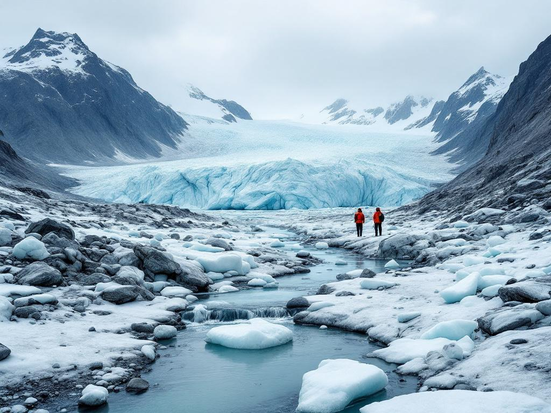
Key Findings: A Year of Records and Alarms
Dramatic acceleration of glacier retreat in the European Arctic in 2025.
Total ice area reduced by 1,124 km² — a 33% increase in loss compared to 2024 (847 km²).
Summer 2025 was the warmest on record, with a mean temperature anomaly of +3.1°C.
First-ever recorded rainfall above 1,500 m on Svalbard in July 2025.
Notes:
This slide sets the stage for the presentation by highlighting the most alarming findings from the 2025 monitoring report. Emphasize the unprecedented nature of the ice loss and temperature anomalies. Transition to the methodology by noting that these findings are backed by rigorous, high-resolution data collection techniques.

Slide 4
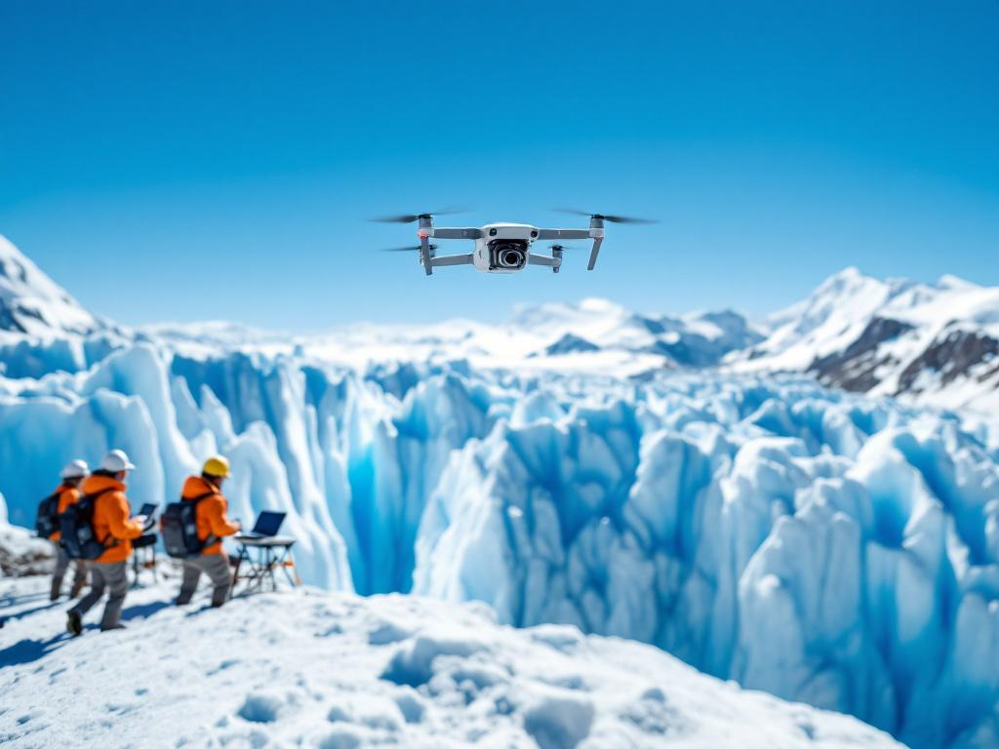
Methodology: Precision Through Innovation
Consistent methodology with the 2024 report (AWI-GLZ-2025-0134).
Introduction of drone-based photogrammetry (DJI Matrice 350 RTK) for high-resolution glacier mapping.
Spatial resolution improved from 10 m to 0.5 m, enabling precise tracking of glacier fronts and calving events.
Data validated against ground measurements and satellite imagery.
Notes:
Explain the significance of the methodological improvements, particularly the shift to drone-based photogrammetry. Highlight how the enhanced resolution allows for more accurate monitoring of rapid changes. Mention that this innovation is critical for detecting events like the Kronebreen calving and rainfall at high altitudes.

Slide 5
Ice Area Loss by Region (2024 vs. 2025)
Region | Ice Area 2024 (km²) | Ice Area 2025 (km²) | Loss (km²) | Retreat (%) | Δ vs. 2024
Svalbard (Total) | 15,870 | 15,140 | 730 | 4.6% | +33%
of which Austfonna | 7,840 | 7,460 | 380 | 4.8% | +36%
of which Nordenskiöld | 2,260 | 2,150 | 110 | 4.9% | +38%
Iceland (Vatnajökull) | 7,490 | 7,240 | 250 | 3.3% | +32%
Northern Scandinavia | 1,310 | 1,218 | 92 | 7.0% | +31%
Novaya Zemlya | 2,813 | 2,761 | 52 | 1.8% | +41%
Total | 27,483 | 26,359 | 1,124 | 4.1% | +33%
Table 1: Ice area and retreat rates by region (2024 vs. 2025). The 'Δ vs. 2024' column shows the acceleration of retreat.
Notes:
This table provides a detailed breakdown of ice area loss across key regions. Highlight the total loss of 1,124 km² and the 33% acceleration compared to 2024. Point out that Northern Scandinavia experienced the highest percentage loss (7.0%), while Svalbard’s sub-regions (Austfonna and Nordenskiöld) saw the most significant acceleration (+36% and +38%, respectively).

Slide 6
Ice Area Loss by Region (2024 vs. 2025)
Bar chart comparing ice area in 2024 and 2025 across key regions. The reduction in ice area is visually apparent in all regions.
Notes:
Use this chart to visually emphasize the widespread nature of ice loss. Note that while all regions show declines, Northern Scandinavia and Svalbard’s sub-regions are particularly affected. Transition to the next slide by mentioning that ice area loss is only part of the story — mass balance data reveals even more concerning trends.

Slide 7
Mass Balance and Volume Loss 2025
Glacier | Accumulation (m w.e.) | Ablation (m w.e.) | Net Balance (m w.e.) | Volume Loss (km³) | Δ vs. 2024
Austfonna | +0.74 | -2.35 | -1.61 | 19.2 | +30%
Vatnajökull | +1.32 | -2.78 | -1.46 | 11.8 | +44%
Nordenskiöld Land | +0.55 | -2.12 | -1.57 | 4.8 | +41%
Storglaciären (SE) | +0.98 | -1.89 | -0.91 | 0.12 | +50%
Central Arctic | +0.78 | -2.31 | -1.53 | — | +49%
Table 2: Mass balance 2025 — significantly more negative than the previous year. Vatnajökull shows the largest increase in volume loss (+44%).
Notes:
This table reveals the stark negative mass balances across all monitored glaciers. Emphasize that Vatnajökull’s volume loss increased by 44%, the highest among all glaciers. Note that even smaller glaciers like Storglaciären experienced a 50% increase in net loss. Highlight the implications for sea-level rise and ecosystem stability.

Slide 8
Mass Balance Comparison (2025)
Net Balance = 0 (Equilibrium)
Bar chart showing accumulation and ablation for each glacier in 2025. All glaciers exhibit strongly negative net balances.
Notes:
This chart visually demonstrates the imbalance between accumulation and ablation. Point out that all glaciers are far below the equilibrium line (net balance = 0), indicating unsustainable losses. Highlight Vatnajökull’s high ablation rate and Storglaciären’s relatively low accumulation. Transition to climate data by noting that these trends are driven by record-breaking temperatures.

Slide 9
Climate Data 2025: Record-Breaking Anomalies
Station | Annual Mean 2025 (°C) | Anomaly (°C) | Precipitation (mm) | Anomaly (%)
Ny-Ålesund (Svalbard) | -1.8 | +3.8 | 520 | +19%
Longyearbyen | -1.4 | +3.5 | 348 | +15%
Stykkishólmur (Iceland) | +5.5 | +1.9 | 845 | +14%
Tromsø (Norway) | +5.0 | +2.3 | 1,185 | +9%
Barentsburg | -2.5 | +4.4 | 465 | +24%
Table 3: Climate data 2025 — all stations show record anomalies. Barentsburg recorded a +4.4°C deviation from the reference period.
Notes:
This table underscores the extreme climatic conditions of 2025. Highlight Barentsburg’s +4.4°C anomaly as the most extreme temperature deviation. Note the increased precipitation across all stations, which may contribute to surface melt through rain-on-snow events. Emphasize that these anomalies are consistent with the accelerated glacier retreat observed.

Slide 10
Temperature and Precipitation Anomalies 2025
Line chart showing temperature and precipitation anomalies for 2025 across monitoring stations. Barentsburg exhibits the highest temperature anomaly.
Notes:
Use this chart to illustrate the correlation between temperature anomalies and precipitation changes. Point out that Barentsburg’s +4.4°C anomaly is an outlier, but all stations show significant warming. Note that increased precipitation, particularly as rain, exacerbates glacier melt. Transition to the next slide by mentioning that these climatic extremes led to unprecedented events in 2025.

Slide 11
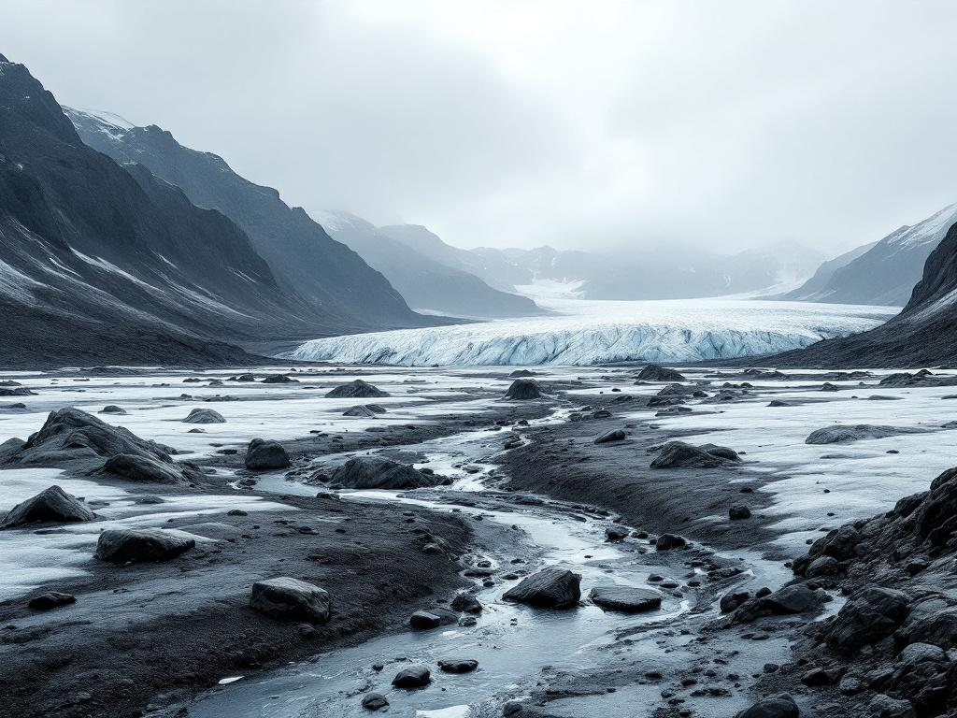
Projections: A Dire Outlook
2038
Projected disappearance of Northern Scandinavian glaciers (previously 2045)
The 33% acceleration in glacier retreat exceeds even the most pessimistic model predictions (RCP 8.5).
Northern Scandinavian glaciers are now projected to disappear by 2038, seven years earlier than previously forecast.
This trend, if unchecked, will have cascading effects on freshwater availability, sea-level rise, and Arctic ecosystems.
Notes:
This key statistic slide delivers a stark warning about the future. Emphasize the revised projection for Northern Scandinavian glaciers and the implications of losing these ice masses seven years earlier than expected. Highlight that this acceleration is outpacing even the worst-case climate scenarios.

Slide 12
Summary: A Call to Action
1. 2025 marked a record-breaking year for glacier retreat in the European Arctic, with a 33% acceleration in ice loss compared to 2024.
2. Total ice area decreased by 1,124 km², driven by unprecedented temperature anomalies (+3.1°C) and extreme events like rainfall at 1,500 m.
3. Mass balance data reveals unsustainable losses, with Vatnajökull’s volume loss increasing by 44%.
4. Climate data shows record-breaking anomalies, including a +4.4°C deviation in Barentsburg.
5. Projections now forecast the disappearance of Northern Scandinavian glaciers by 2038, seven years earlier than previously expected.
6. Urgent actions are required: establish an early warning system, increase research funding by 40%, and strengthen climate policies.
Notes:
This summary slide reinforces the key takeaways from the presentation. Emphasize the urgency of the situation and the need for immediate action. Highlight the role of the audience in advocating for policy changes and supporting scientific research. End with a call to action, urging collaboration to address the accelerating glacier retreat and its global implications.

Slide 13
Sources
Möller, M. et al. (2024): Svalbard glacier mass loss accelerating beyond model predictions. The Cryosphere 18, 2847-2865.
Johansson, E. et al. (2025): Record summer 2025 — Arctic glaciers in freefall. Nature Climate Change 15(8), 612-618.
IPCC (2025): Special Report on the Cryosphere — Updated Projections. AR7 Supplementary Material.

